Slide 1
India Design Week 2026
CHALLENGING, INSPIRING & FUTURISTIC

Slide 2
Team ID & Project Name
TEAM – 745
Modular Disaster-Relief Rescue Cart with Foldable Stretcher System

Slide 3
Objectives and Goals
To design a lightweight and portable rescue cart
To enable easy transport of injured persons in rough terrain
To ensure quick assembly within limited time
To integrate stretcher, storage, and mobility in one system
To maintain strength while reducing overall weight

Slide 4
Challenges
Maintaining stability on uneven surfaces
Keeping the structure lightweight and strong
Ensuring quick folding and assembly
Balancing load distribution (person + supplies)

Slide 5
Project Description
It combines a stretcher with a wheeled base
Includes a simple suspension system for shock absorption
Storage compartments are provided below the frame
Designed for disaster zones with limited access
Notes:
Bottom Up- With bottom-up approach users start to design a product by detailing its low-level component. These components are then grouped into higher-level components. The process is continued until the very top component is corresponding to the product

Slide 6
Design Process
Studied existing rescue and stretcher systems
Identified key requirements (mobility, strength, simplicity)
Created basic frame structure in Fusion 360Added suspension, storage, and folding legs
Finalized dimensions and materials

Slide 7
Product Functionality
Carries injured person safely on stretcher
Spring suspension reduces shock and vibration
Storage boxes carry essential medical supplies
Notes:
Component names with Render Images and its working
Include your innovation and creative in this area

Slide 8
Analysis reports
Designed to support 120 kg load
Stable structure with wide wheelbase
Spring reduces shock and vibration
Strong and lightweight materials used
Safe and durable for rough conditions

Slide 9
Cost estimation
S.No | Component | Material | Quantity | Cost (₹)
1 | Main Frame | Aluminum 6061 | 1 | 1500 – 2000
2 | Support Legs | Mild Steel | 2 | 500 – 700
3 | Wheels (16–20 inch) | Rubber + Steel | 2 | 1600
4 | Suspension System | Spring Steel + Steel | 2 | 600 – 900
5 | Storage Boxes | Polypropylene | 3 | 900
6 | Stretcher Fabric | Canvas | 1 | 400 – 600
7 | Fasteners & Joints | Steel | Set | 300 – 500
8 | Handle Grip | Rubber | 2 | 100 – 200

Slide 10
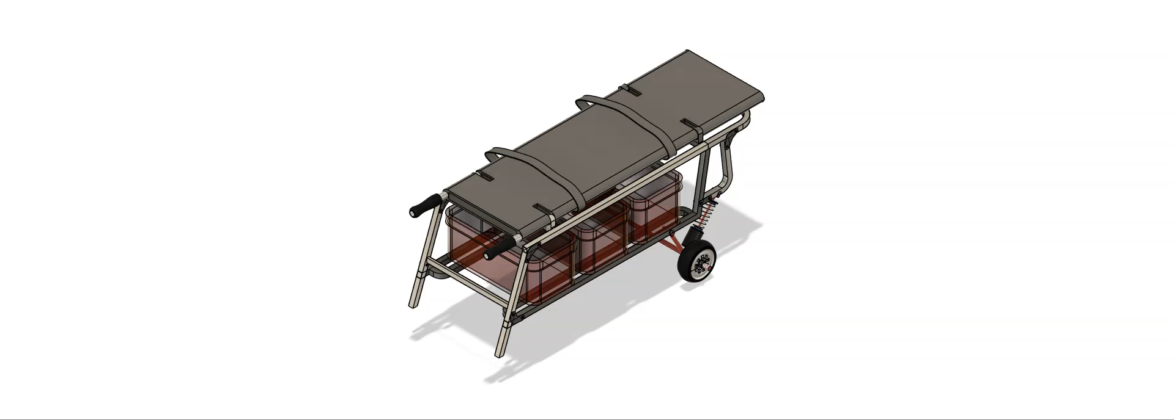
Relevant doc, images, videos, & Conceptional design

